Slide 1

Sakila movie rental analysis
Power BI Reporting & Business Analysis Project
Excel | SQL |Power BI | DAX
By: Pravallika Manepalli

Slide 2

TABLE OF CONTENTS
Project Overview
Data Cleaning & Preparation
Data Modeling & DAX
Executive Dashboard
Customer & Sales Analysis
Film & Inventory Analysis
Staff & Store Performance
Geographic Revenue Analysis
Key Insights & Business Findings
Conclusion & Recommendations

Slide 3

PROJECT OVERVIEW
Objective
The objective of this project is to analyze the Sakila Movie Rental database and build an interactive Business Intelligence dashboard to uncover insights related to revenue, customer behavior, film performance, inventory trends, store operations, and geographic revenue distribution.
Business Goals
• Analyze rental revenue trends across different countries • Understand customer purchasing behavior and payment preferences • Identify top-performing film categories and inventory patterns • Evaluate staff and store performance • Generate actionable business insights using Power BI dashboards
Excel
SQL
Power BI
DAX
Business Insights
Project Workflow

Slide 4

DATA CLEANING & PREPARATION
Data Source
The project uses the Sakila Movie Rental database containing customer, rental, payment, film, inventory, staff, and store-related data.
Cleaned and validated raw data using Excel
Checked for missing values and inconsistencies
Removed duplicate and unnecessary records
Standardized column formats and data types
Verified data accuracy before SQL loading
Data Cleaning Process
SQL Data Preparation
• Imported cleaned datasets into SQL Workbench • Verified table relationships and data integrity • Performed data validation checks using SQL queries
Raw Data → Excel Cleaning → SQL Loading → Validation → Power BI

Slide 5
DATA MODELING & DAX
Data Modeling
• Built table relationships in Power BI • Connected customer, rental, payment, film, and inventory tables • Created a structured relational data model
DAX Measures
• Total Revenue • Total Rentals • Total Customers • Average Customer Rating • Top Revenue Country • Top Film Category
Outcome
Created dynamic KPI measures and an optimized data model for interactive dashboard reporting.

Slide 6
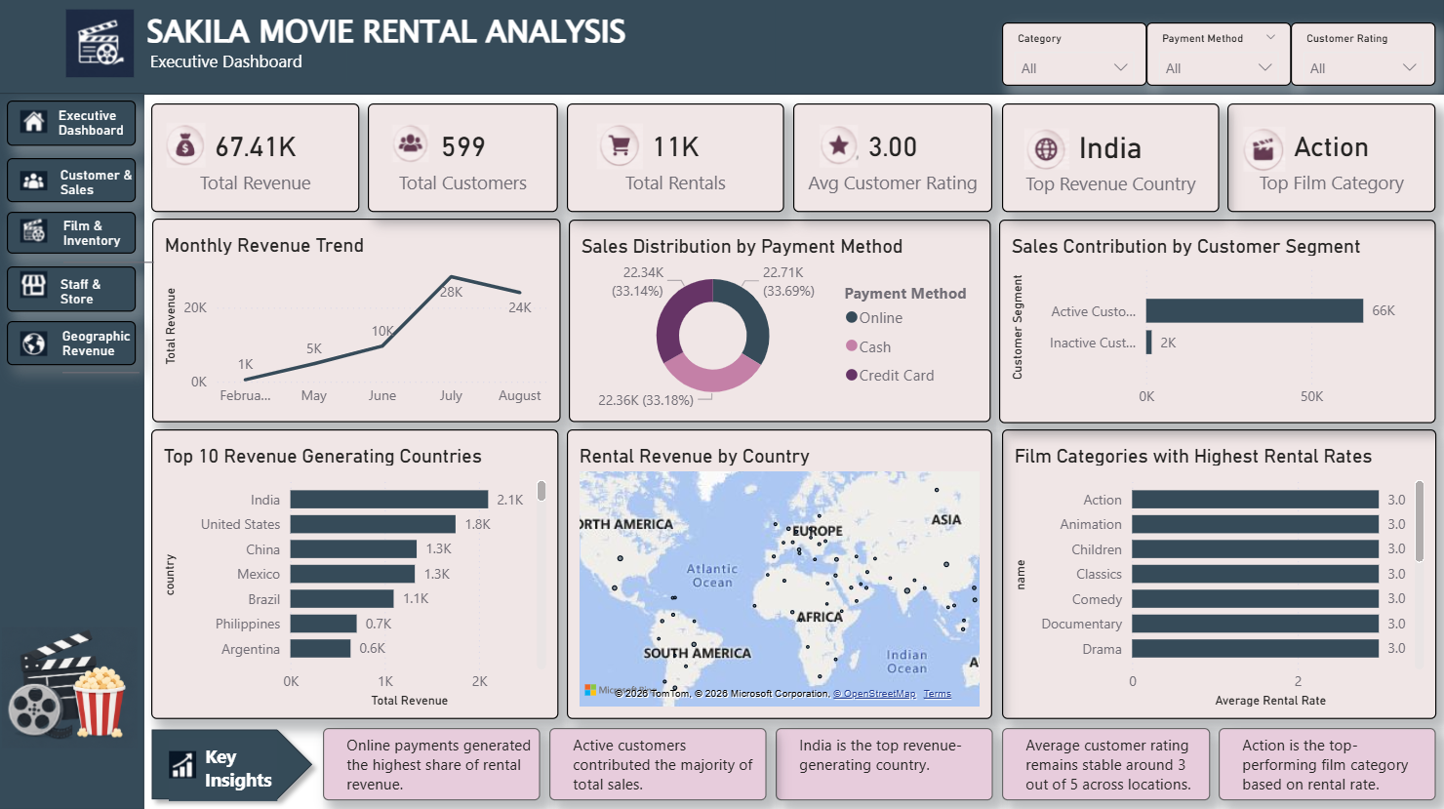
EXECUTIVE DASHBOARD
The Executive Dashboard provides a consolidated view
of rental business performance through interactive KPIs, revenue trends, customer insights, payment analysis, and geographic revenue distribution.
Key Features
• Interactive slicers and page navigation • Dynamic KPI tracking using DAX measures • Revenue and customer trend analysis • Geographic and category-based insights • User-friendly executive reporting interface
Business Value
The dashboard enables quick decision-making by transforming raw rental data into meaningful business insights through interactive visual reporting.

Slide 7

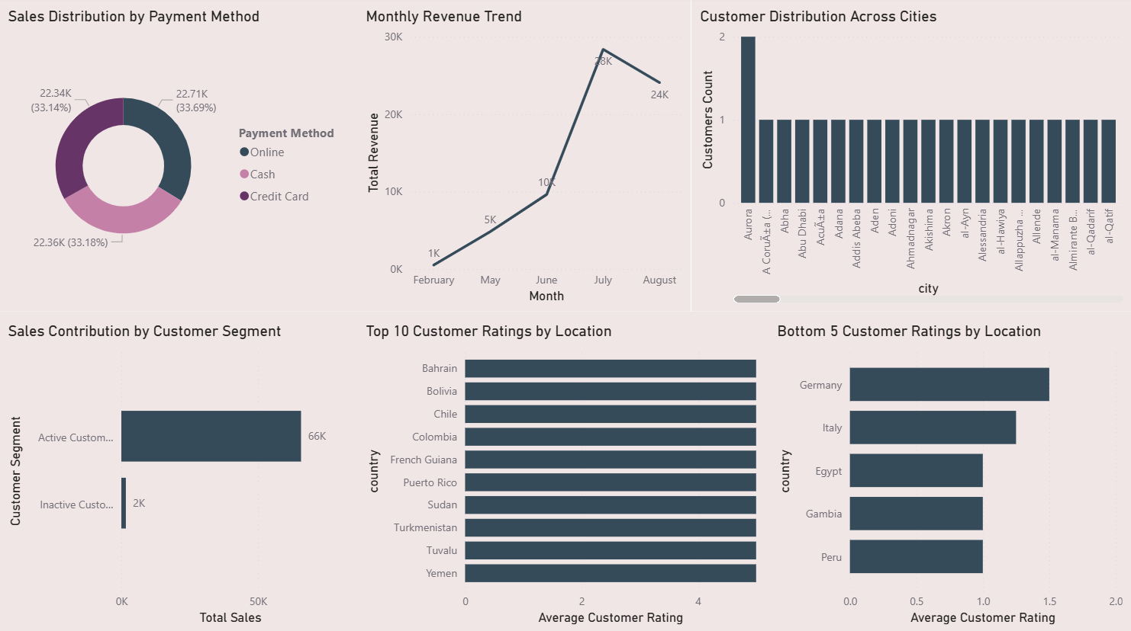
CUSTOMER & SALES ANALYSIS
This section analyzes customer behavior, sales contribution, payment preferences, and customer rating trends to understand overall rental business performance.
Key Areas Analyzed
• Sales distribution by payment method • Monthly revenue trends • Customer segmentation analysis • Customer ratings by location • Customer distribution across cities
Key Insights
• Online payments generated the highest share of revenue • Active customers contributed the majority of total sales • Revenue showed strong growth during peak months • Customer ratings remained stable across most locations
Business Value
Customer and sales analysis helps identify purchasing behavior, revenue-driving customer segments, and payment trends for better business decision-making.

Slide 8

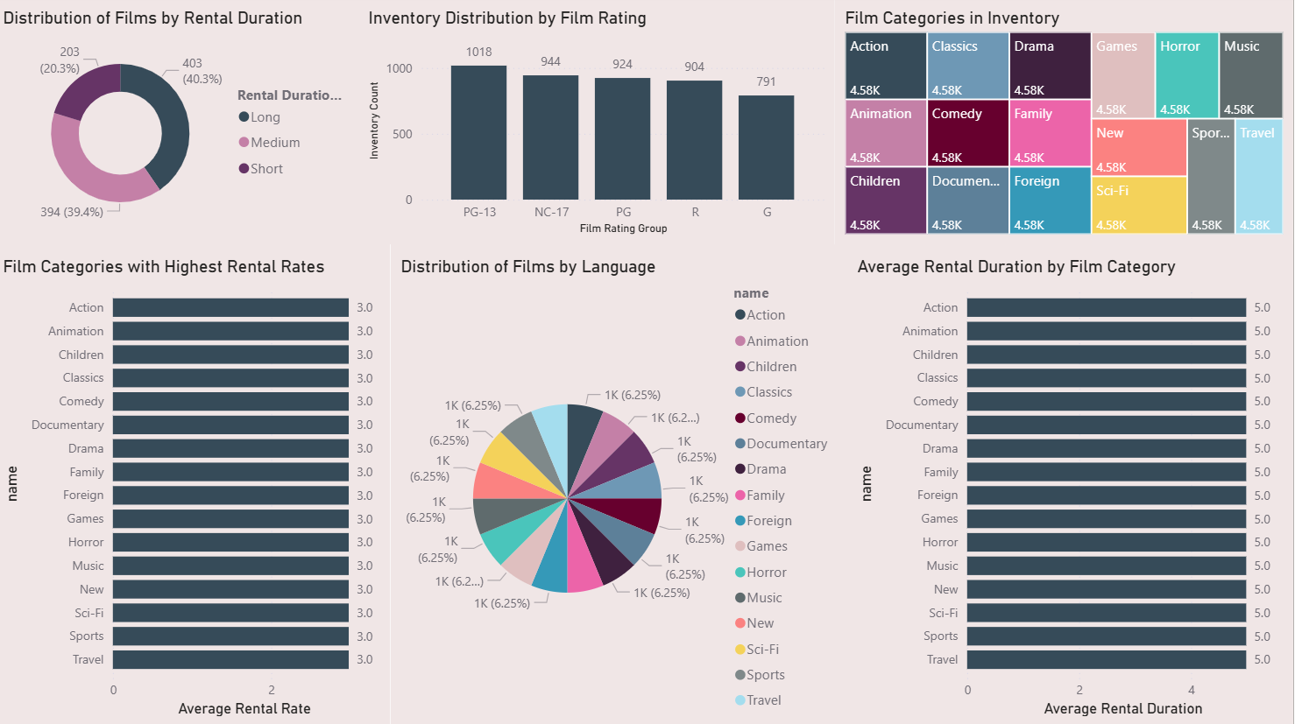
FILM & INVENTORY ANALYSIS
This section analyzes film categories, rental duration, inventory distribution, and film ratings to evaluate inventory performance and rental patterns.
Key Areas Analyzed
• Distribution of films by rental duration • Inventory distribution by film rating • Film categories in inventory • Average rental duration by category • Film categories with highest rental rates
Key Insights
• Action category showed strong rental performance • Film inventory was distributed across multiple rating groups • Rental duration remained consistent across categories • Inventory distribution supported category diversity
Business Value
Film and inventory analysis helps identify high-performing categories, optimize inventory allocation, and improve rental strategy decisions.

Slide 9
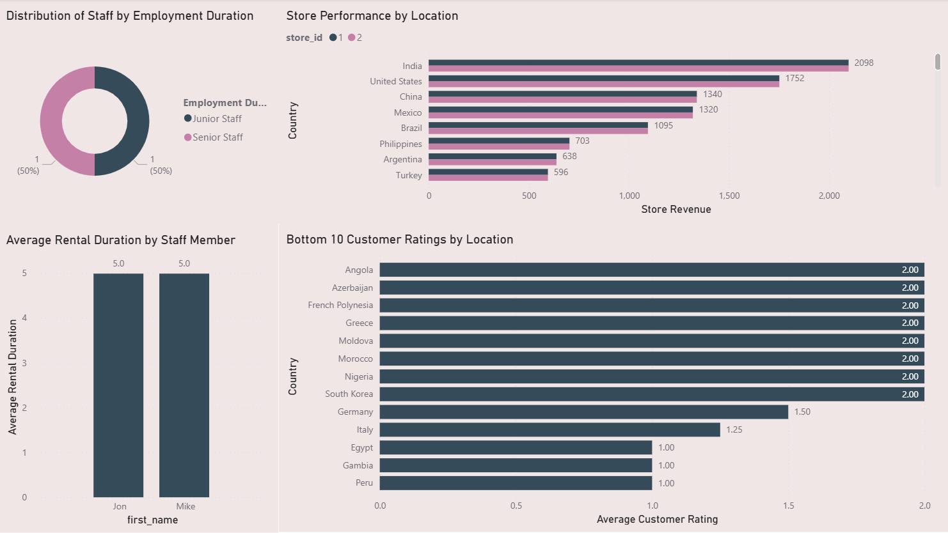
STAFF & STORE PERFORMANCE
This section analyzes staff performance, store revenue contribution, employment distribution, and customer rating trends to evaluate operational efficiency.
Key Areas Analyzed
• Distribution of staff by employment duration • Store performance by location • Average rental duration by staff member • Customer ratings across locations
Key Insights
• Store revenue varied across different countries • Staff rental duration remained consistent • Revenue contribution was higher in top-performing locations • Customer ratings showed moderate variation across regions
Business Value
Staff and store performance analysis helps evaluate operational effectiveness, monitor store contribution, and support better business management decisions.

Slide 10

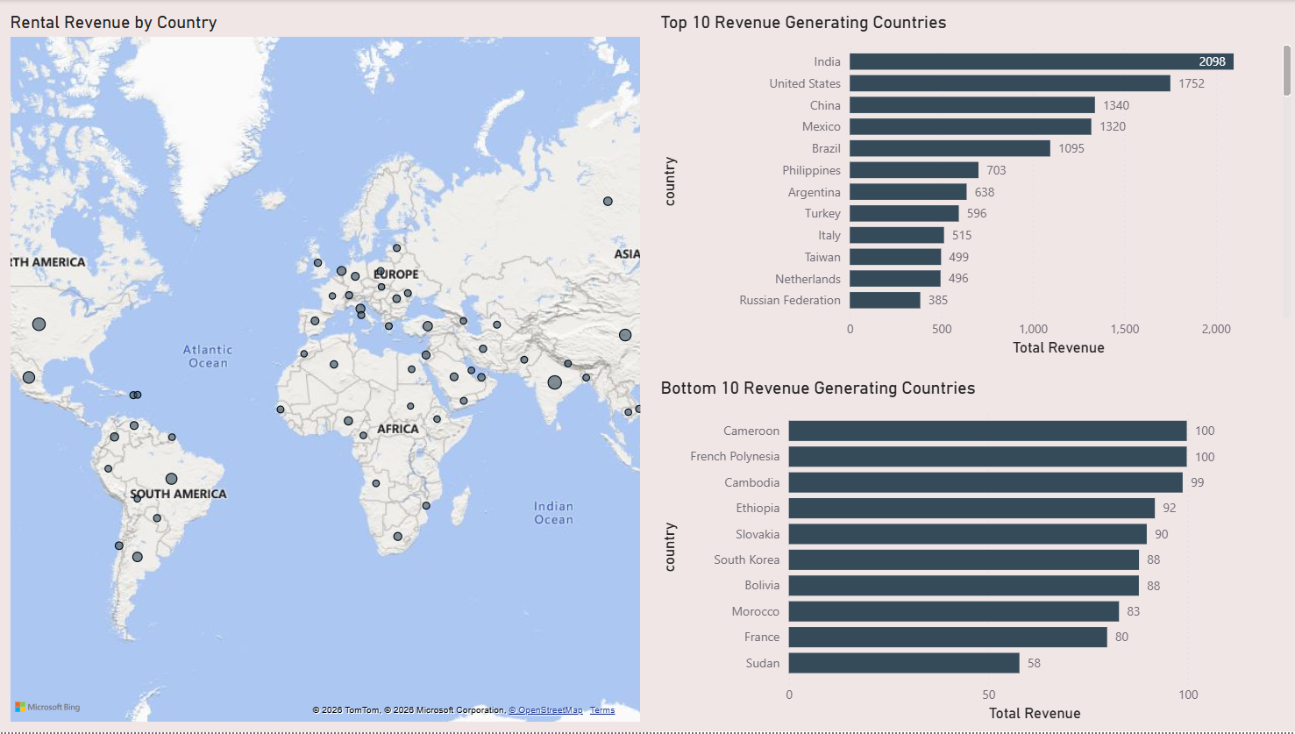
GEOGRAPHIC REVENUE ANALYSIS
This section analyzes country-wise revenue distribution to identify high-performing and low-performing geographic regions.
Key Areas Analyzed
• Rental revenue by country • Top revenue-generating countries • Bottom revenue-generating countries • Geographic revenue distribution trends
Key Insights
• India generated the highest rental revenue • Revenue contribution varied significantly across countries • Several regions showed low revenue performance
• Geographic analysis highlighted major revenue-driving
markets
Business Value
Geographic revenue analysis helps identify profitable regions, monitor market performance, and support strategic business expansion decisions.

Slide 11
KEY INSIGHTs
India generated the highest rental revenue
Online payments contributed the highest sales share
Active customers drove most of the revenue
Action was the top-performing film category
Revenue increased significantly during peak months
business findings
Geographic regions showed uneven revenue distribution
Payment preferences influenced sales performance
Interactive dashboards improved business analysis
Inventory diversity supported rental demand
Customer behavior strongly impacted revenue trends

Slide 12
CONCLUSION
The Sakila Movie Rental Analysis project successfully transformed raw rental data into meaningful business insights through interactive Power BI dashboards, KPI analysis, and data-driven reporting.
RECOMMENDATIONS
• Focus on high-performing geographic regions to maximize revenue • Encourage digital payment methods to improve sales efficiency • Expand inventory for top-performing film categories • Improve engagement strategies for inactive customers • Use dashboard insights for continuous business monitoring and decision-making
Thank You

